Slide 1
Bank Churners
Will they leave or not?

Slide 2
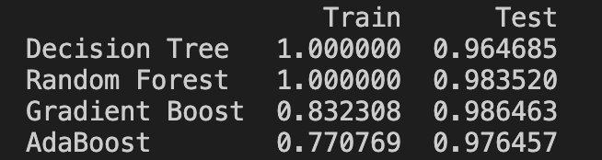
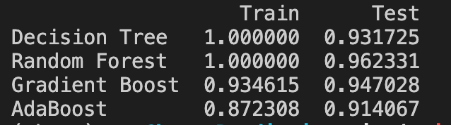
Deciding the classifier
1. Without balancing the data
2. After balancing the data

Slide 3
What about clusters?
K-Means:

Slide 4
Demonstration
Explainerdashboard:
http://192.168.0.21:9050/
(For now only available locally)

Slide 5
To be done
Optimize the model:
Eliminate factors without influence
Index = Client number
Remove balancing
Deployment!

Slide 6
Q&A
Thank you very much!

Slide 7
Issues to be solved
Docker: local time-out
Heroku

Slide 8
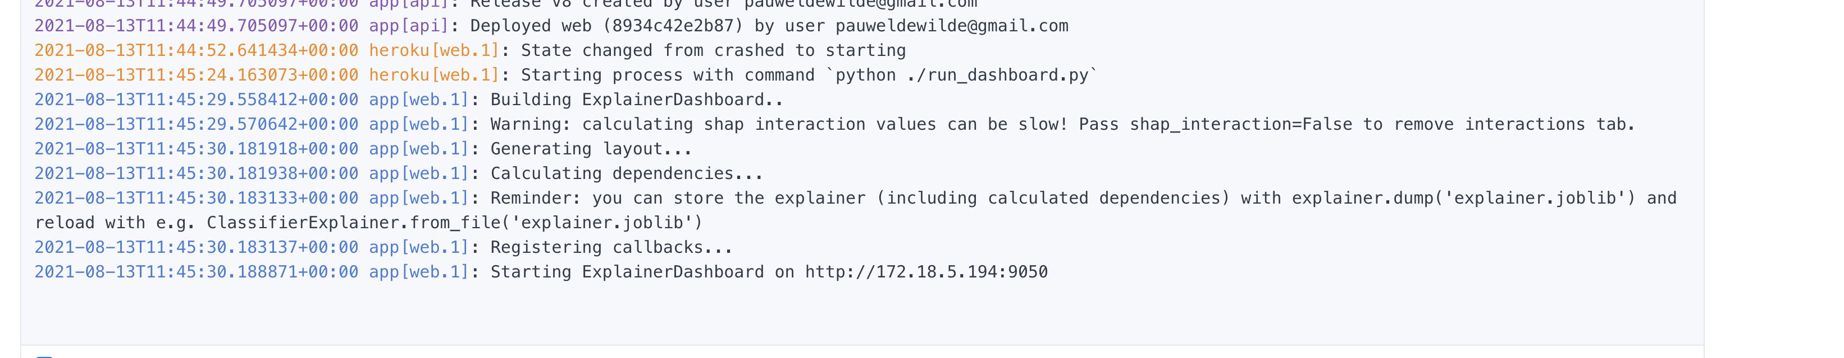
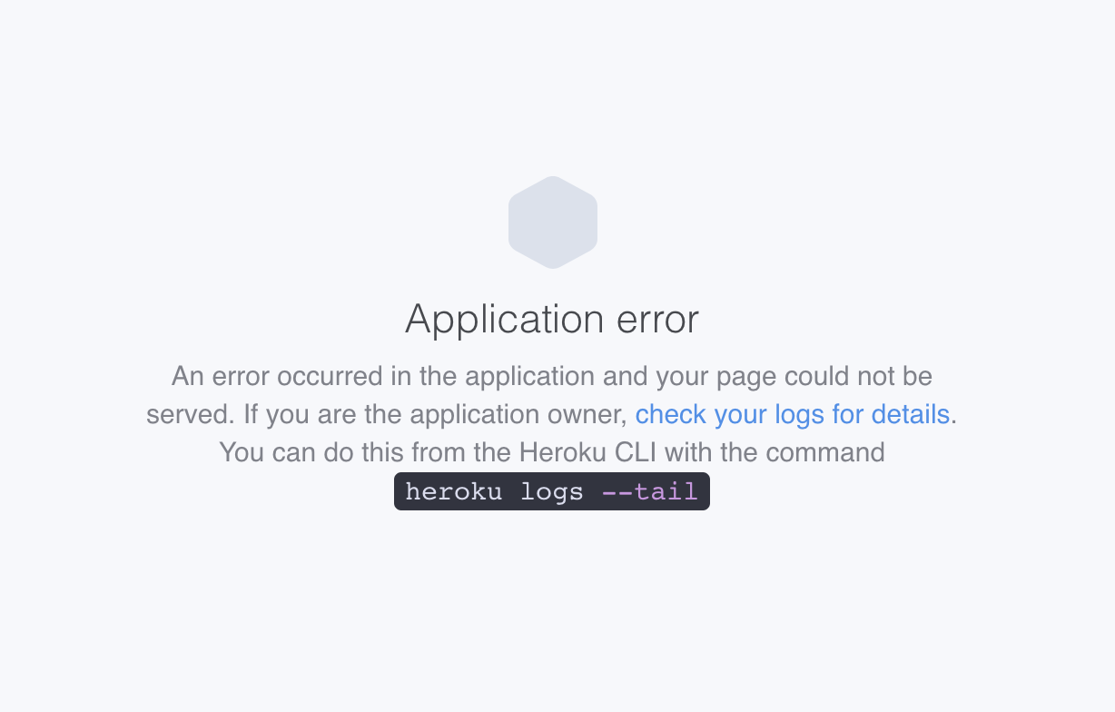
Heroku

Slide 9
Probable solutions
Deployment:
directly load joblib / yaml?
dash?
pay for Heroku?
Programming:
drop SHAP values, serialize, …
Save the cleaned database seperately and load

